Slide 1


INFORMATION EXTRACTION
Semantic Text-Mining for the language of chemical experiments

Slide 2
ChemicalTagger PURPOSE
Using NLP and text-mining tools, extraction of chemical entities and the relationships between those entities will make the resulting data available in a machine-processable format enabling automatic analysis of chemical synthesis by a machine. Processing millions of chemical reactions, in turn could lead to significant improvements in our ability to do science.
Drug Discovery
Material Science
Environmental Science
https://www.ncbi.nlm.nih.gov/pmc/articles/PMC3117806/

Slide 3

UNIVERSITY OF CAMBRIDGE Department of Chemistry Molecular Informatics
Center For Molecular Informatics
- members from the Department of Chemistry
involved in computational chemistry, chemical information,
biological sciences and medicine
Department of chemistry is a world-class teaching and research center involved in:
Drug Discovery
Energy Research
Computer Memory and Sensors
Oil Recovery
Ageing
Public research university in Cambridge, United Kingdom
https://www-cmi.ch.cam.ac.uk/research-centre-molecular-informatics

Slide 4
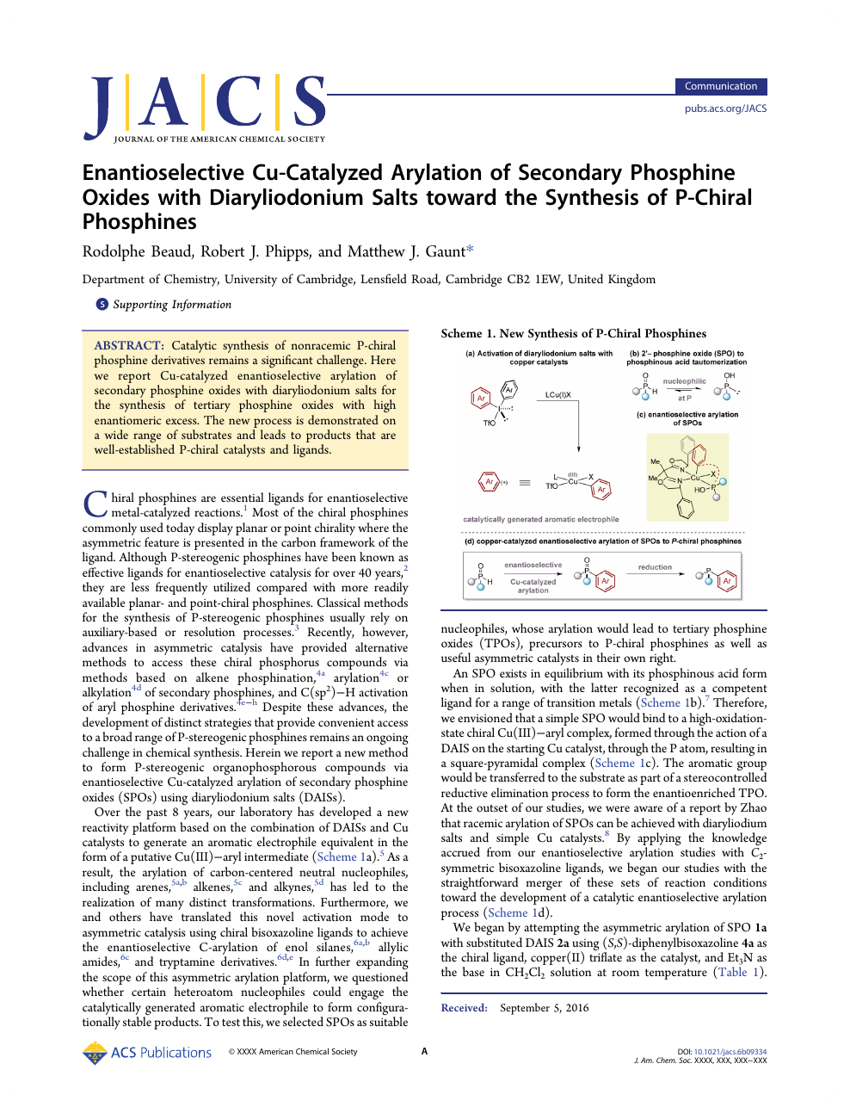
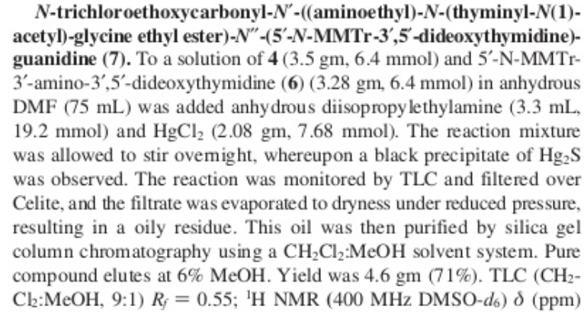
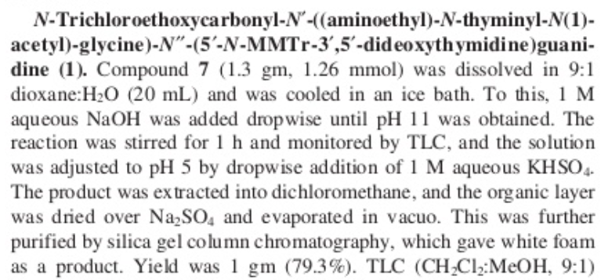
SOURCE OF TEXT
Example of a Research Publication
Experimental Procedures:
- Is a portion of research publication describing the synthetic process of a chemical product
Examples
https://www.slideshare.net/DineshBarawkar/jacs-2000-1222252445250-deoxynucleic-guanidine-and-peptide-nucleic-acid-chimeras-synthesis

Slide 5
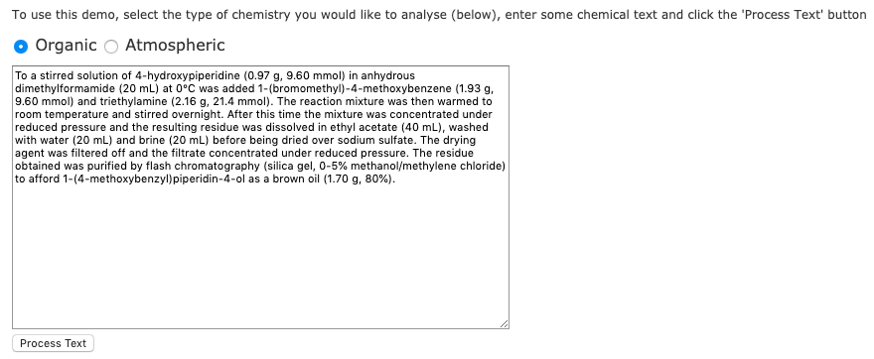
ChemicalTagger Demo Text Ready for Processing
ChemicalTagger Link
http://chemicaltagger.ch.cam.ac.uk/

Slide 6
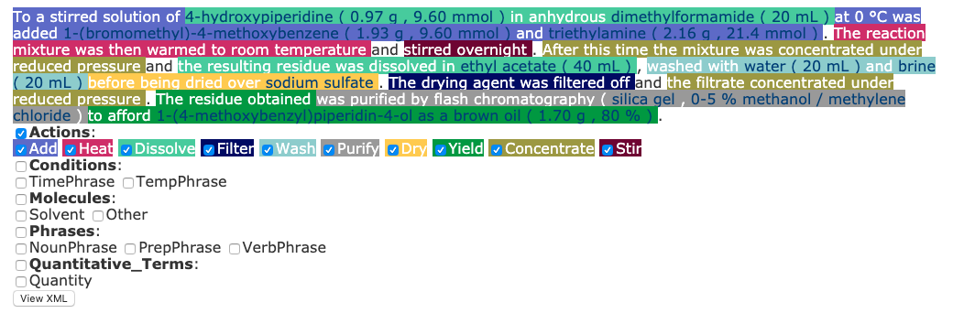
ChemicalTagger Demo Processed Text
ChemicalTagger Link
http://chemicaltagger.ch.cam.ac.uk/

Slide 7
ChemicalTagger OBSERVATIONS
To test the tagging and parsing capabilities, various experimental procedures from different journal articles were used. Specifically, different synthetic molecules were selected, in order to test the ability to detect chemical nomenclature, conditions , etc. The tool is highly accurate at recognizing chemical nomenclature, including chemical names that do not include atom locants within the name as most do, which is impressive. It was able to detect a product vs. reactant molecules based on the yield provided, along with purification methods and other actions taken by the chemist. Seeing the POS tags application in this field and having an understanding due to this course have cleared up many questions I had previously, which is exciting!
https://www.ncbi.nlm.nih.gov/pmc/articles/PMC3117806/

Slide 8
REFERENCES
https://en.wikipedia.org/wiki/University_of_Cambridge
https://www.ncbi.nlm.nih.gov/pmc/articles/PMC3117806/
https://www-cmi.ch.cam.ac.uk/research-centre-molecular-informatics
https://www.ch.cam.ac.uk/about?_ga=2.112634372.1202141662.1575748918-568987223.1575748918
https://www.slideshare.net/DineshBarawkar/jacs-2000-1222252445250-deoxynucleic-guanidine-and-peptide-nucleic-acid-chimeras-synthesis
http://chemicaltagger.ch.cam.ac.uk/

